Slide 1
Genome Variation

Slide 2
Learning Objectives
To become familiar various characteristics of genome variation
To learn the different classes and features of genome variation

Slide 3
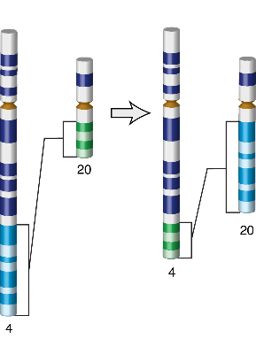
Different classes of genome variation
AATCTGAGGCAT
AATCTCAGGCAT
Single Nucleotide Polymorphism (SNPs)
1bp
Small Insertions/Deletions (INDELs)
1bp to 50bp (arbitrary)
Structural Variation (SVs)
50bp+ (arbitrary)
Encompasses:
Deletion
Duplication
Novel Sequence Insertions
Mobile Element Insertions
Translocations
Inversions
AATCTGAAGGCAT
AATCT--AGGCAT

Slide 4
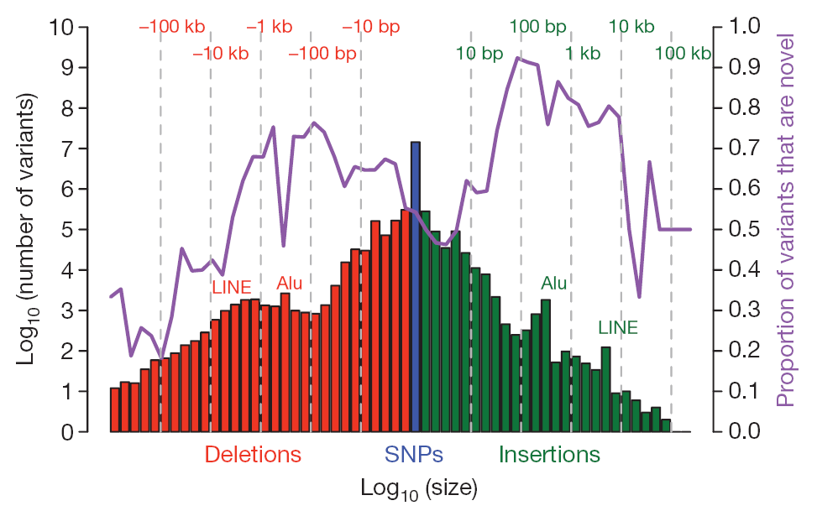
Genome changes vary in size
Durbin, R., Altshuler, D., Durbin, R. et al. A map of human genome variation from population-scale sequencing. Nature 467, 1061–1073 (2010). https://doi.org/10.1038/nature09534

Slide 5
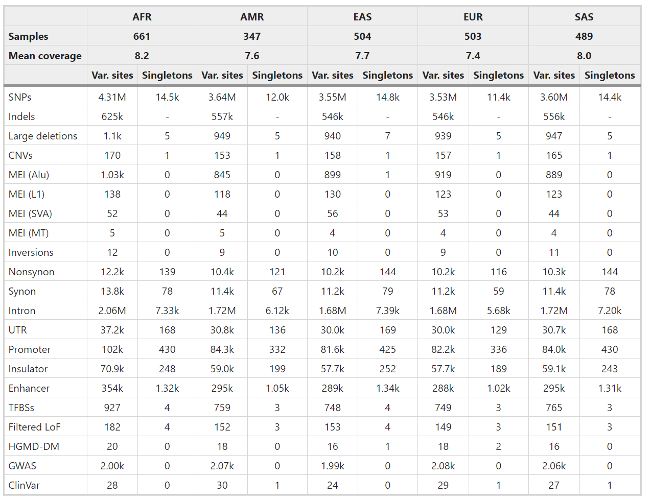
Genomic changes vary in abundance
Auton, A., Abecasis, G., Altshuler, D. et al. A global reference for human genetic variation. Nature 526, 68–74 (2015). https://doi.org/10.1038/nature15393

Slide 6
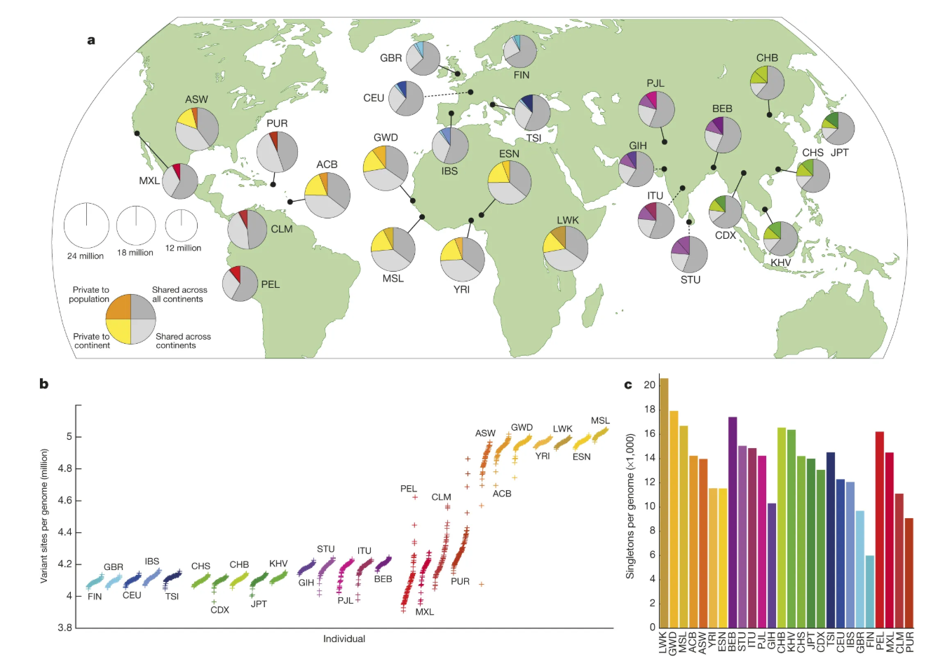
Genomic changes vary in geographical distribution
a, Polymorphic variants within sampled populations. The area of each pie is proportional to the number of polymorphisms within a population. Pies are divided into four slices, representing variants private to a population (darker colour unique to population), private to a continental area (lighter colour shared across continental group), shared across continental areas (light grey), and shared across all continents (dark grey). Dashed lines indicate populations sampled outside of their ancestral continental region. b, The number of variant sites per genome. c, The average number of singletons per genome.
Auton, A., Abecasis, G., Altshuler, D. et al. A global reference for human genetic variation. Nature 526, 68–74 (2015). https://doi.org/10.1038/nature15393

Slide 7
A typical human genome
Differs from the reference human genome at 4.1-5 million sites
Majority (>99.9%) are SNPs and short indels
Contains 2,100 to 2,500 structural variants affecting ~20Mb of sequence and comprising (approximately):
1000 large deletions
160 copy number variants
915 Alu insertions, 128 L1 insertions, 51 SVA insertions
4 numts
10 inversions
Majority of variants in a single genome are common
Only 40,000 to 200,000 per genome (1-4%) have a frequency <0.5%
Auton, A., Abecasis, G., Altshuler, D. et al. A global reference for human genetic variation. Nature 526, 68–74 (2015). https://doi.org/10.1038/nature15393

Slide 8
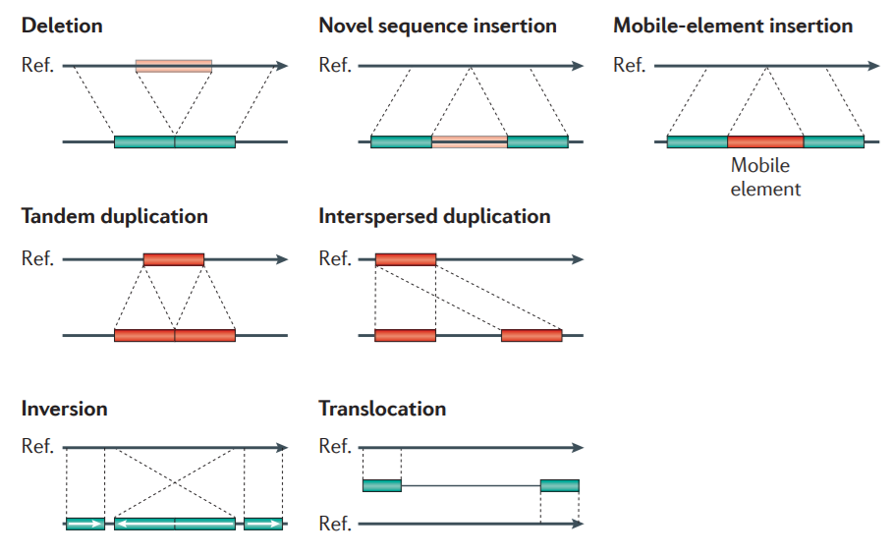
Structural Variation
Structural variation (SV) is generally defined as a region of DNA approximately 1 kb 50bp and larger in size and can include inversions and balanced translocations or genomic imbalances (insertions and deletions), commonly referred to as copy number variants (CNVs)
From: https://www.ncbi.nlm.nih.gov/dbvar/content/overview/
Alkan et al., 2011 Nat. Rev. Genet.

Slide 9
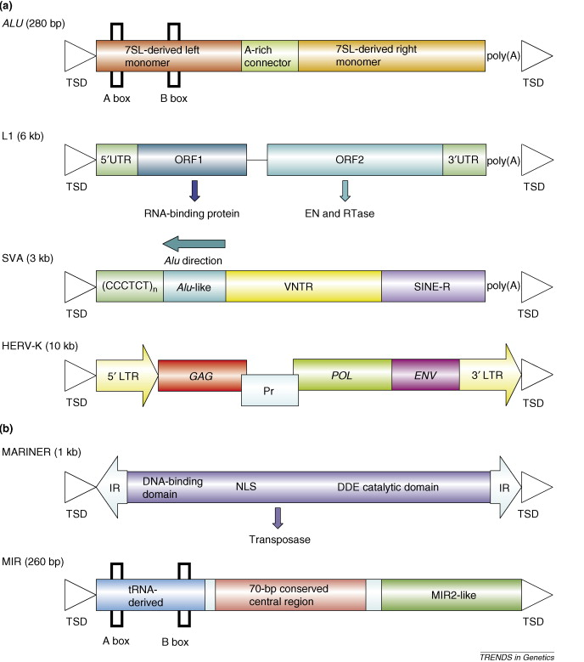
Transposons
Transposable elements are DNA sequences which can move to another location, either via a copy-paste (class I) or cut-paste (class II) mechanism
In this manner, they are identical or very similar to each other and therefore are often termed repetitive elements
In mammals, almost half of the genome is made up of transposons, although many are inactive remnants
Retrotransposons are a subclass of transposons that pass through an RNA intermediate in a similar mechanism to retroviruses.
Structures of recently active (a) and inactive (b) transposable elements present in the human genome.
Mills et al. (2007) Trends in Genetics, 23(4), pp 183-191

Slide 10
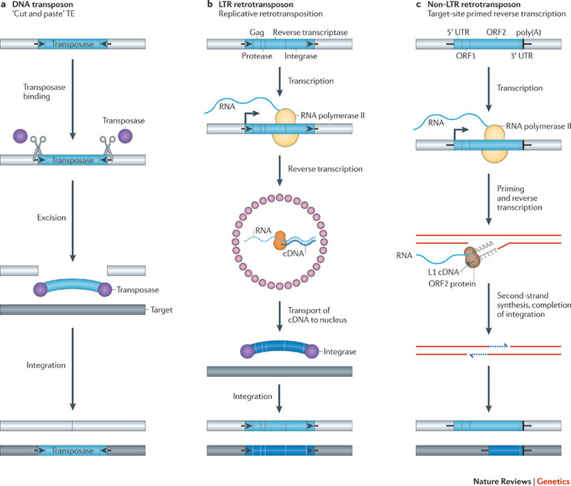
Transposon Mobilization
Levin HL and Moran JV (2011) Nat Rev Genet, 12, pp 615-627

Slide 11
Human Retrotransposons
Active human transposons have been estimated to generate about one new insertion per 10–100 live births
The human genome browser hosted by the University of California, Santa Cruz currently contains over 4 million annotated transposon copies belonging to at least 848 families and subfamilies of elements
~1 million Alu elements
~500,000 LINE-1 (L1) elements
The vast majority of human retrotransposons are inactive due to truncation of their 5’ ends during integration or accumulation of deleterious mutations over time

Slide 12
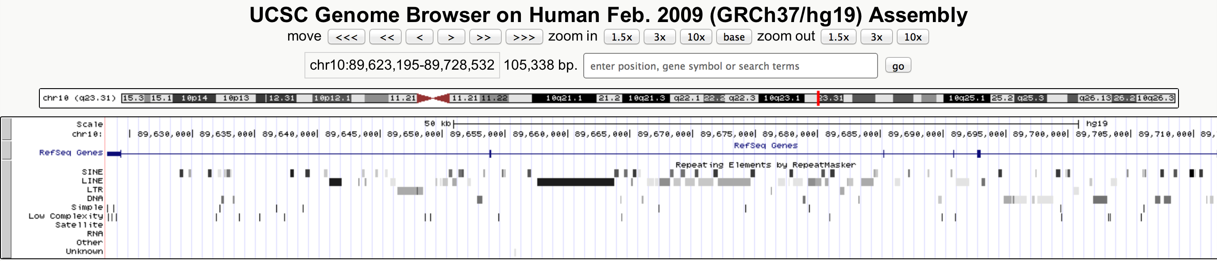
Identifying Repeats
RepeatMasker is a software package that identifies known repetitive and low complexity DNA sequences
Tandem Repeats Finder identifies two or more adjacent, approximate copies of patterns of nucleotides
Reference genomes are often masked using these software, with repeat regions either replaced with Ns or converted to lower case
RepeatMasker track on UCSC Genome Browser for Human Reference

Slide 13
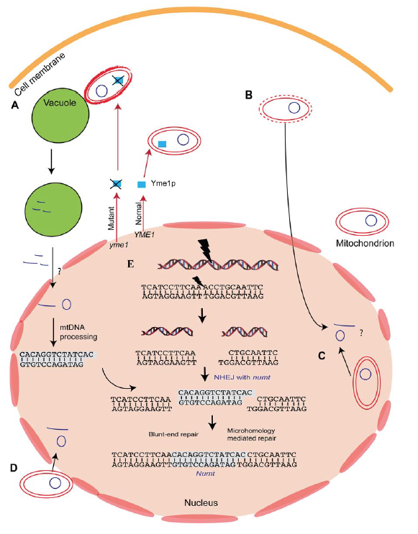
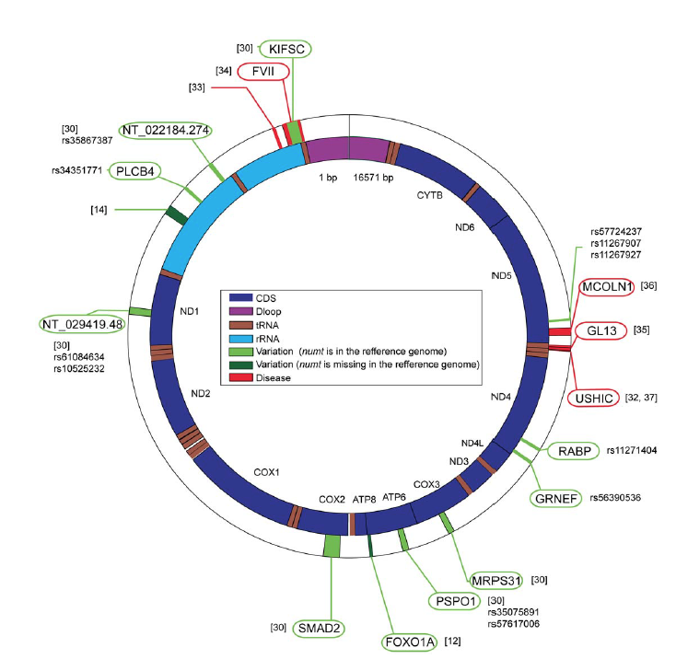
Mitochondrial Insertions (numts)
The human reference genome has ~800 numts varying in size, up to entire mitochondrial genome insertions!
Hazkani-Covo E et al (2010) PLoS Genet, 6(2), e1000834

Slide 14
Pseudogenes
Pseudogenes are regions of DNA resembling genes but lacking protein-coding ability
Pseudogenes are classified as:
Processed, formed from the retrotransposed mRNA of a gene and therefore lacking introns and promoters
Duplicated, containing the full genic structure of an existing gene but having become disabled over time via mutations
Disabled, existing in functional form in other species but having become disabled since the last common ancestor

Slide 15
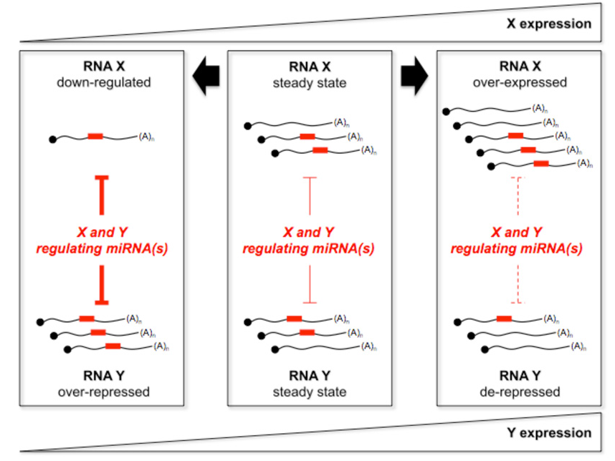
Functional Roles of Pseudogenes
Many pseudogenes are transcribed to some extent
Expressed pseudogenes may act as decoys for regulatory elements (miRNAs), or play a more direct role in gene silencing (siRNAs)
General model for endogenous miRNA decoy mechanism
Modified from Poliseno et al. (2010) Nature, 465(7301), pp. 1033-1038

